Slide 1
Decentralized Applications (DApp)
Under the guidance of N.Krishnaiah sir.
Pramesh Bajracharya – 14221A0566
Abhishek Shrestha – 14221A0563
Saurav Bajracharya – 14221A0567
Sundar Ghimire – 14221A0576

Slide 2
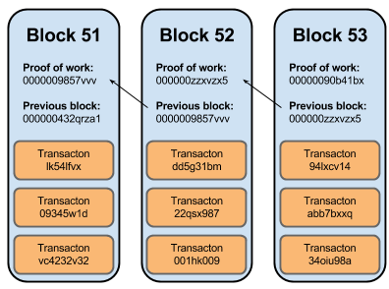
Decentralized Applications - Definition
Decentralized applications (dApps) are applications that run on a P2P network of computers rather than a single computer.
A blockchain is a ledger of records
organized in ‘blocks’ that are linked
together by cryptographic hash
validation
Each block typically contains
a hash pointer as a link to a
previous block, a timestamp
and transaction data.

Slide 3
Criteria for Decentralized Application(Dapps)
The application must be completely open-source, it must operate autonomously, and with no entity controlling the majority of its tokens.
The application's data and records of operation must be cryptographically stored in a public, decentralized blockchain in order to avoid any central points of failure.
The application must generate tokens according to a standard cryptographic algorithm acting as a proof.
The application must use a cryptographic token. Eg: Bitcoin, Ethereum.

Slide 4
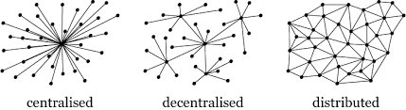
Entering into Decentralization

Slide 5
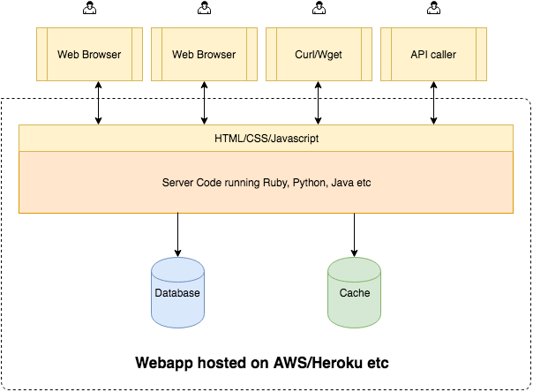
Centralized Application

Slide 6
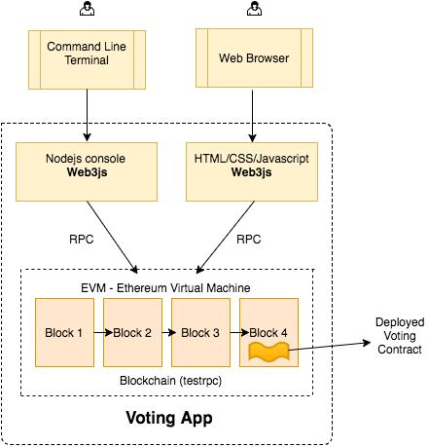
Decentralized Applications

Slide 7
Advantages Of deCEntralization
Decentralized applications surpasses the Single Point of Failure (SOF) problem.
Blockchain makes data transparent and make everyone involve in it, plus it is open source.
It removes the need of data centers to store huge amount of data.
Data quality is maintained by massive database replication and computational trust. This mean data cannot be altered or deleted.
Can reduce the cost by huge margin when dealing in business perspective.

Slide 8
Disadvantage of Decentralization
Speed of decentralized application are comparatively more slower.
It is extremely difficult for developers to develop in blockchain due to its infancy and small communities.
Data Immutability is not always good. Somethings might need some changes.
It makes machine learning and data science learning difficult as data is distributed all across the nodes in internet.
The platform is itself under development and is not completely ready hence bugs and minor glitches can arise time and again.

Slide 9
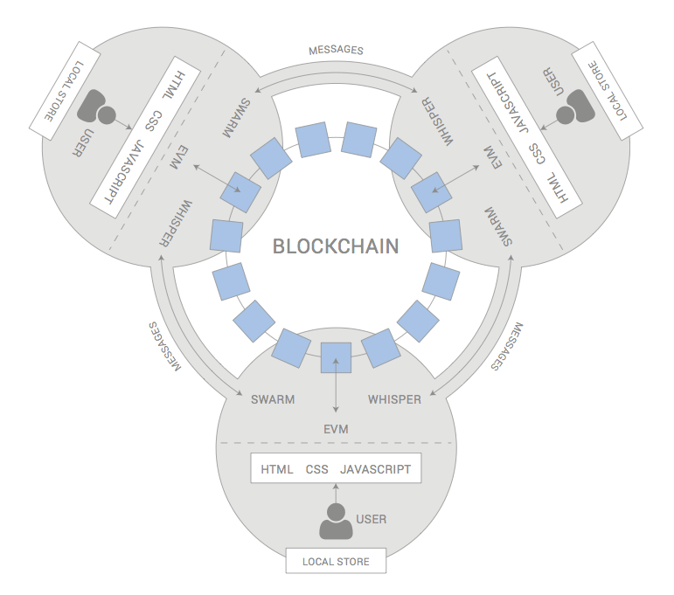
General architecture of a d-app

Slide 10
Requirements
Solidity (contract-oriented programming language)
JavaScript – Web3JS.
Ganache or TESTRPC (Local Blockchain Environment)
MetaMask (Web3 Injection Chrome/ FireFox Extension)
Truffle Framework
Node-Package-Manager (NPM)
ReactJS Library (FrontEnd)
Browser (Chrome, Firefox , Safari, etc. ) Anyone

Slide 11
Solidity
Solidity is a contract-oriented, high level programming language for writing smart contracts.
It was influenced by C++, Python and JavaScript and is designed to target the Ethereum Virtual Machine (EVM).
Solidity is statically typed, supports inheritance, libraries and complex user-defined types among other features.
Solidity is compiled to bytecode that is executable on the EVM.

Slide 12
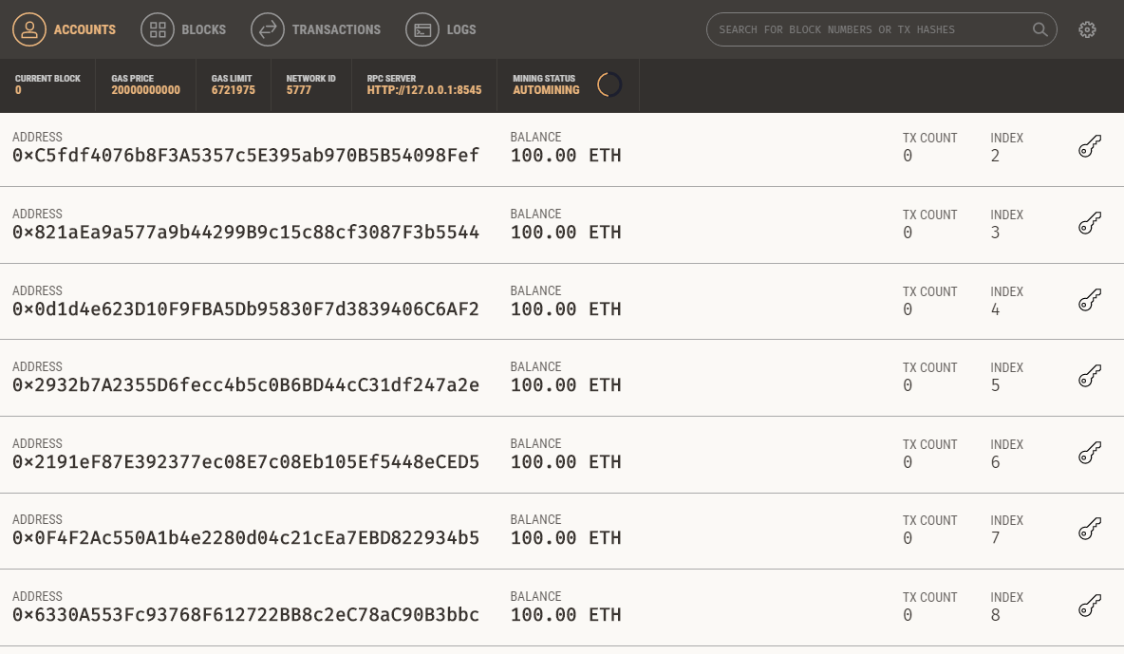
Ganache
Quickly fire up a personal Ethereum blockchain which we can use to run tests, execute commands, and inspect state while controlling how the chain operates.

Slide 13
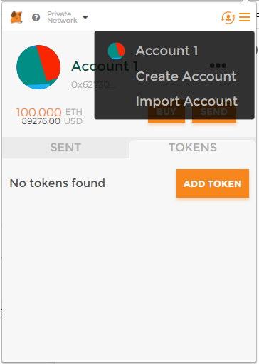
MetaMask
MetaMask is a bridge that allows us to visit the distributed web of tomorrow in your browser today.
It allows us to run Ethereum dApps right in our browser without running a full Ethereum node.
In simple word it injects the web3 into our app environment.

Slide 14
Truffle Framework
Built-in smart contract compilation, linking, deployment and binary management in windows , mac and linux.
Truffle takes care of managing our contract artifacts so we don't have to.
Includes support for custom deployments, library linking and complex Ethereum applications.

Slide 15
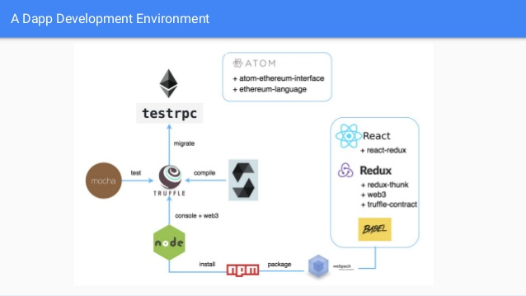
Truffle Architecture

Slide 16
Node-Package-Manager
npm is a package manager for the JavaScript.
The registry has millions for packages and is currently top
Package manager in the world.
Daily thousands of open source contribution in npm made JavaScript the most popular programming language according to Stack Overflow Developer Survey and Github Survey Report.

Slide 17
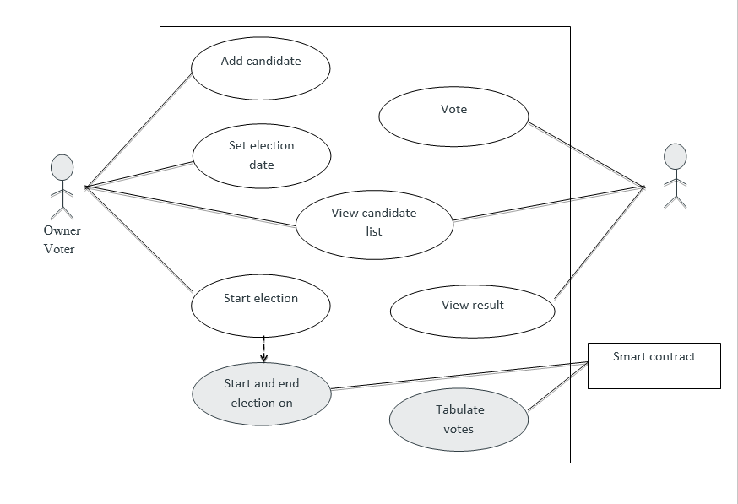
Working Diagrams
Use case diagram for Voting app.

Slide 18
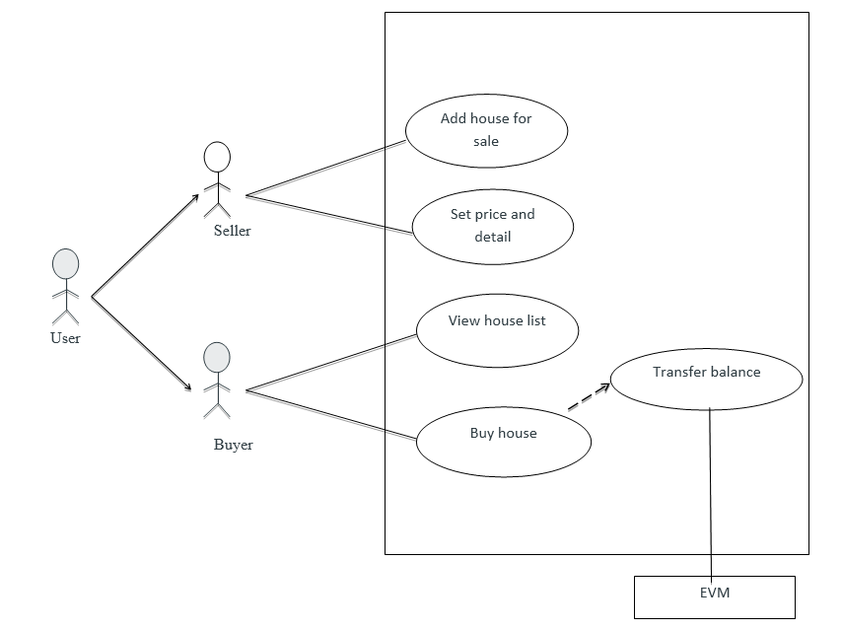
Use case diagram for Real Estate Application

Slide 19
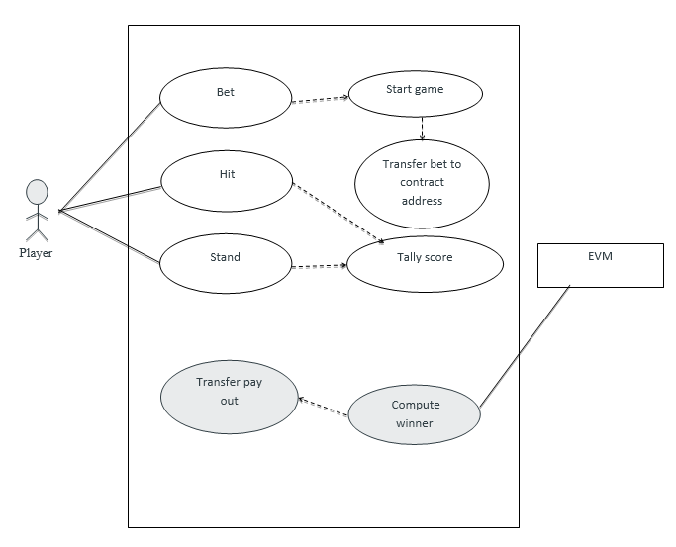
Use case diagram for Black Jack Game:

Slide 20
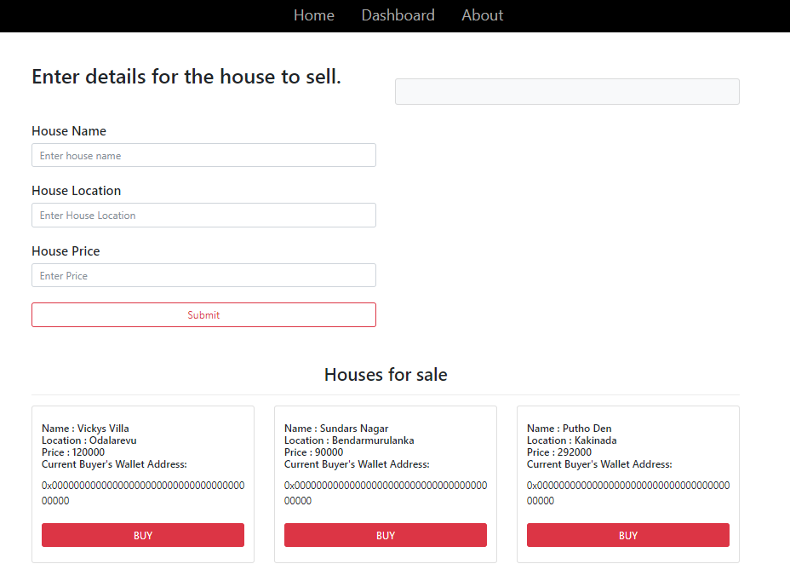
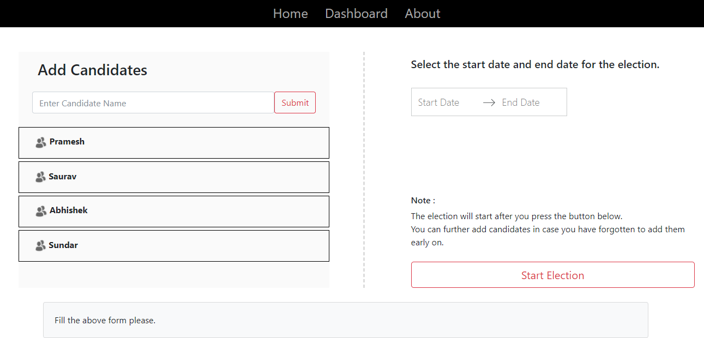
Our Decentralized Applications
Real Estate Application
Voting Application

Slide 21
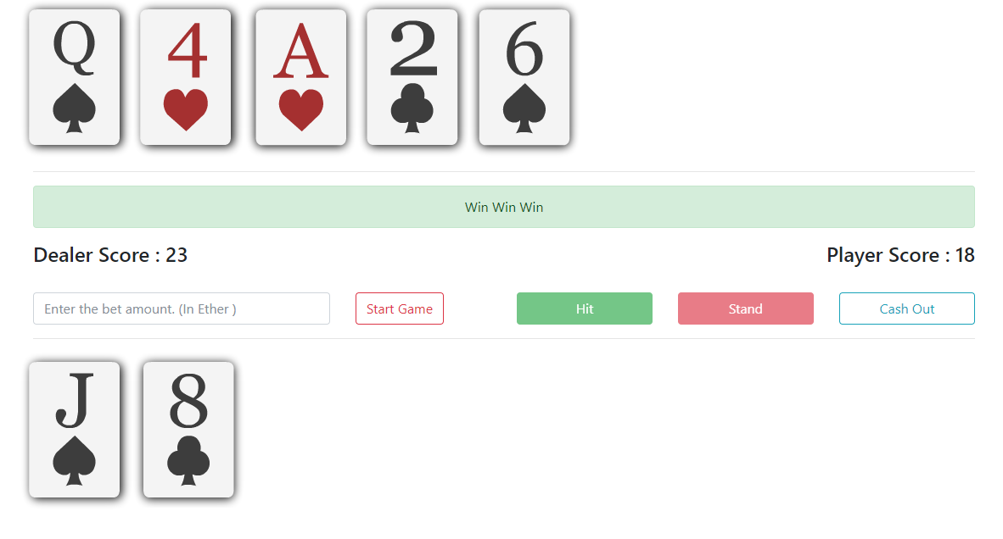
Our Decentralized Applications
Black Jack

Slide 22
Possible applications of dApps :
Digital signatures that ensure authenticity and proof of existence of documents.
Slock It is developing smart locks.
Digital tokens pegged to fiat currencies.
Digital tokens pegged to gold.
Improved digital rights management for music.
Platforms for prediction markets.

Slide 23
Platforms for crowdfunding.
Social media platforms with economic incentives.
Decentralized marketplaces.
Remittance.
Online gambling.
Electric car charging management.
Secure identity systems for the Internet.
Labour economics.
Video Games.

Slide 24
Thank you
Feel free to ask any queries

